Slide 1

Westwood
School Committee
March 19, 2026

Slide 2
Superintendent’s
Report
March 19, 2026

Slide 3
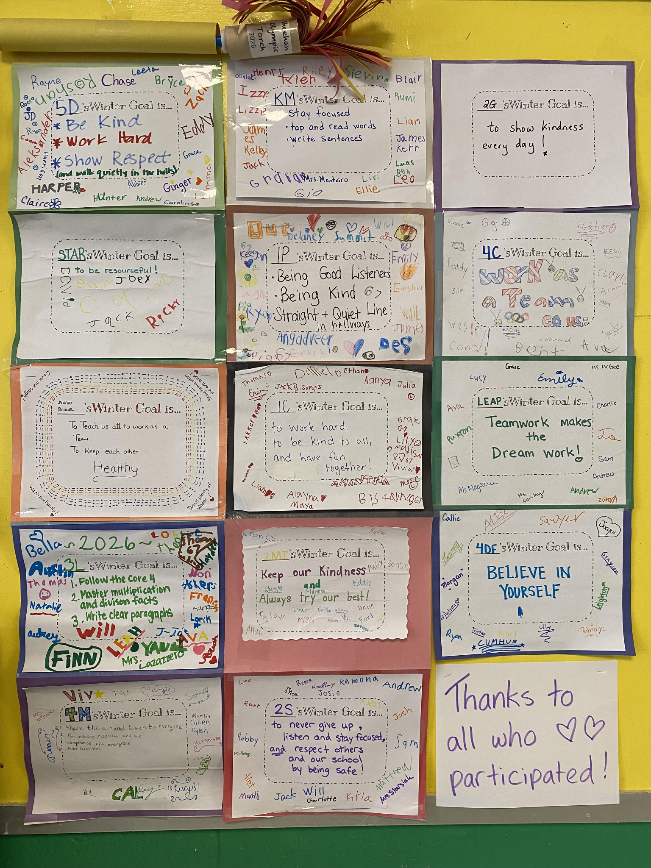

Seen Around WPS…
Notes:
Sheehan: (Left) An Olympic torch was passed from class to class, and each class added a winter goal to the scroll inside the torch. The scroll was then unrolled and displayed. (Right) Students dressed in green for Saint Patrick’s Day this week.

Slide 4
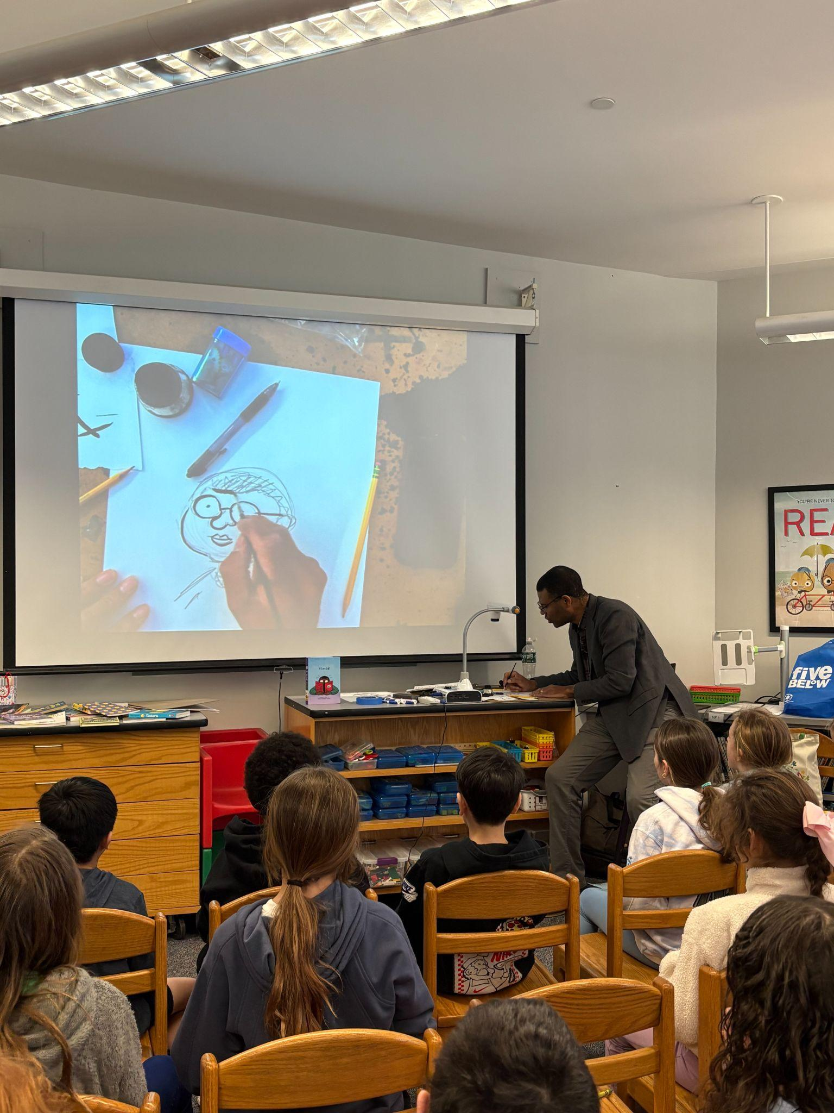
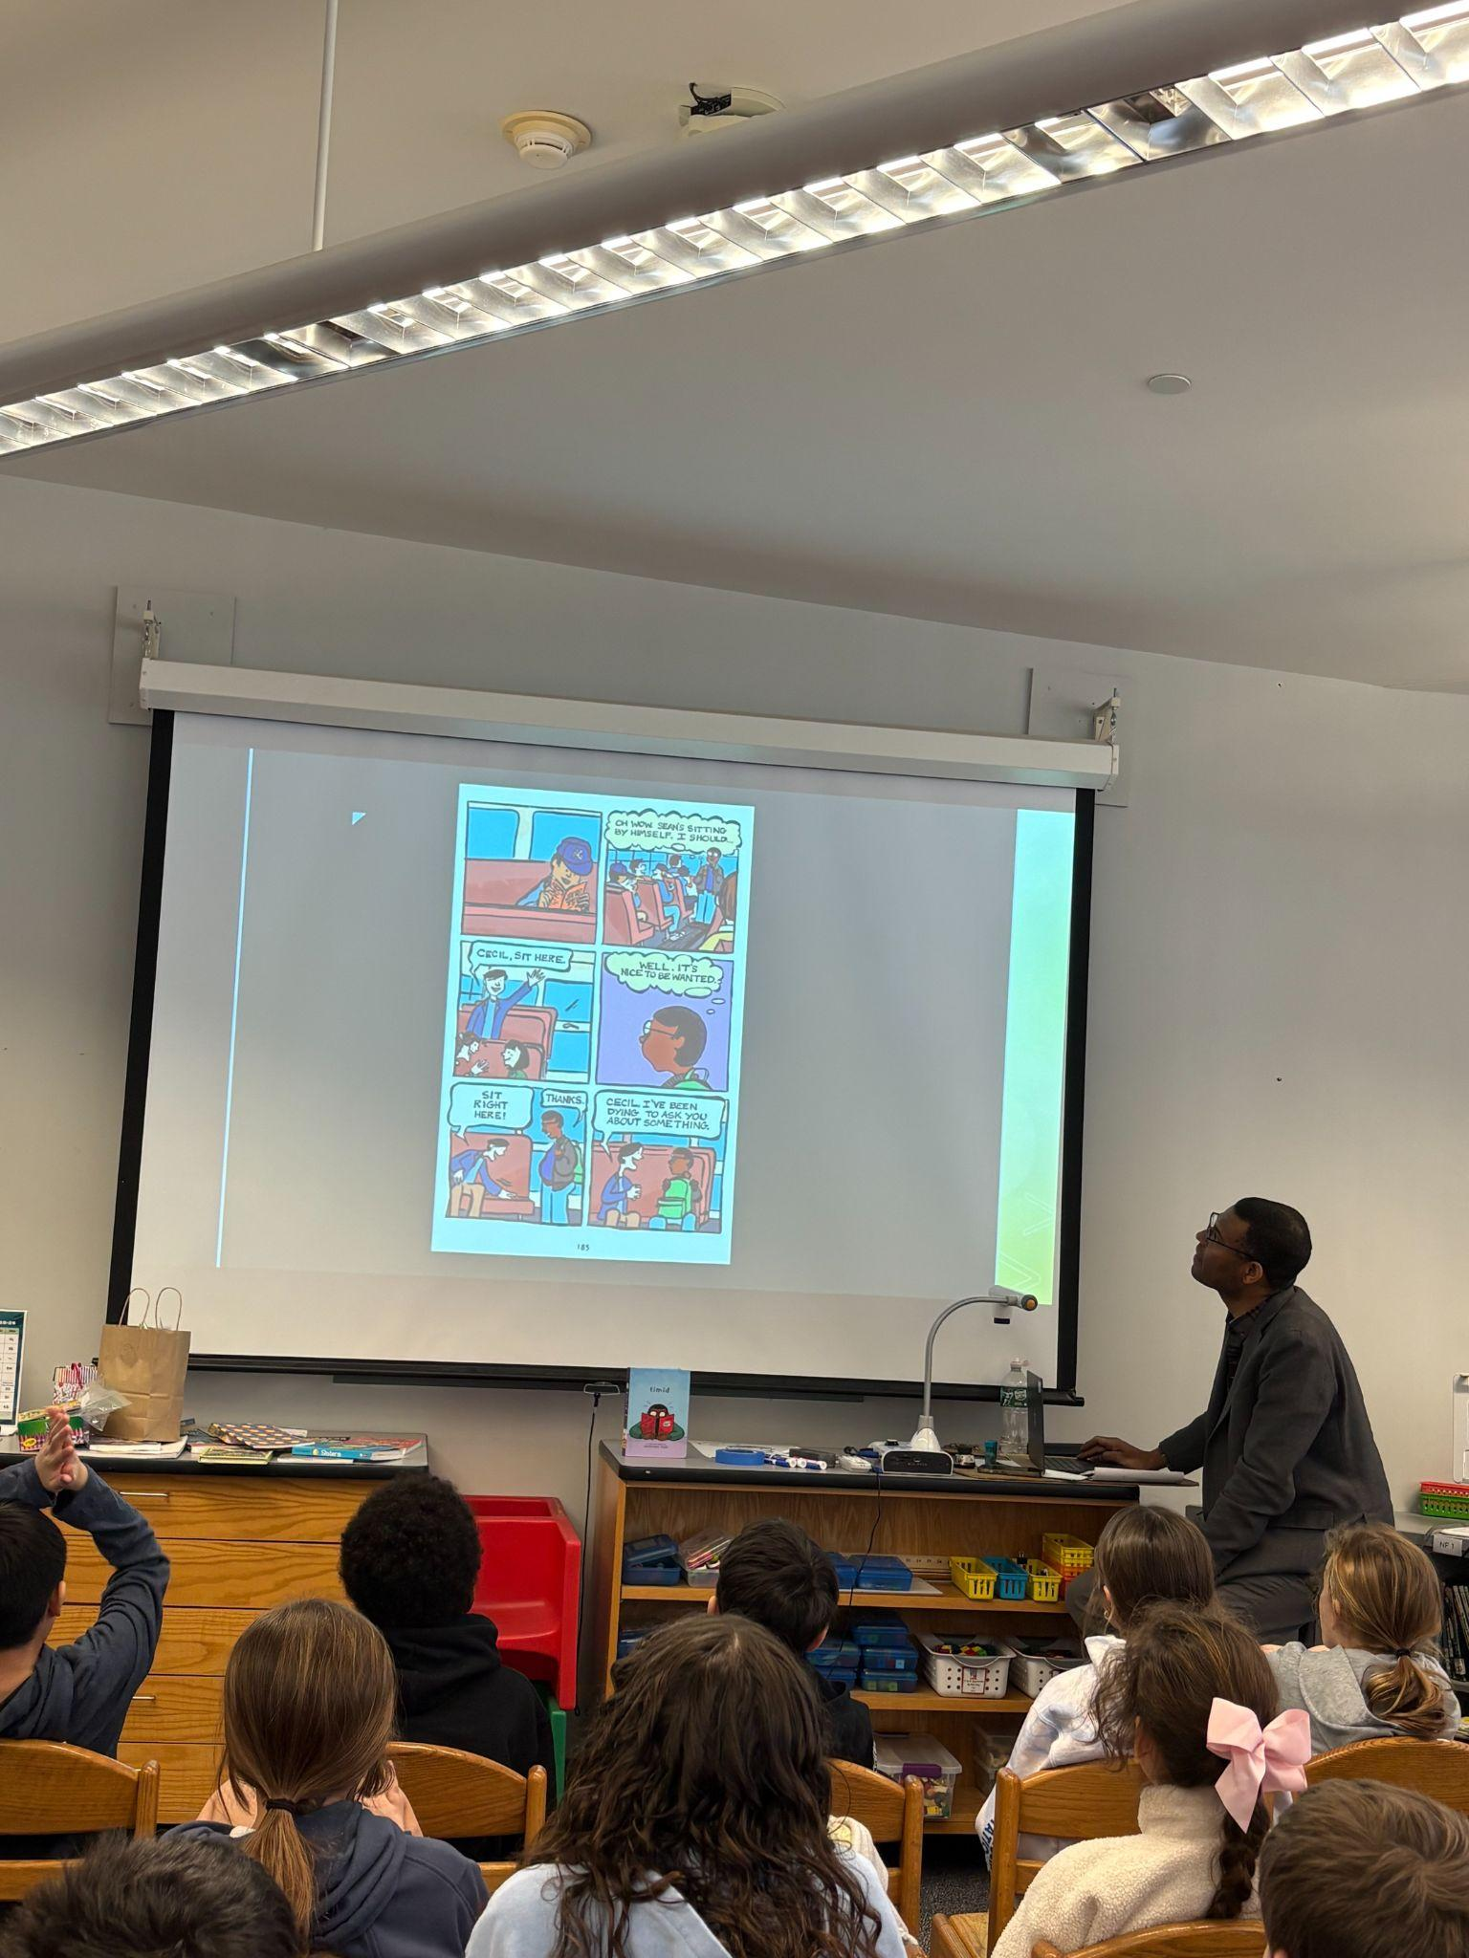
Seen Around WPS…
Notes:
Downey: Author/illustrator/graphic artist Jonathan Todd met with students in grades 4 and 5.

Slide 5
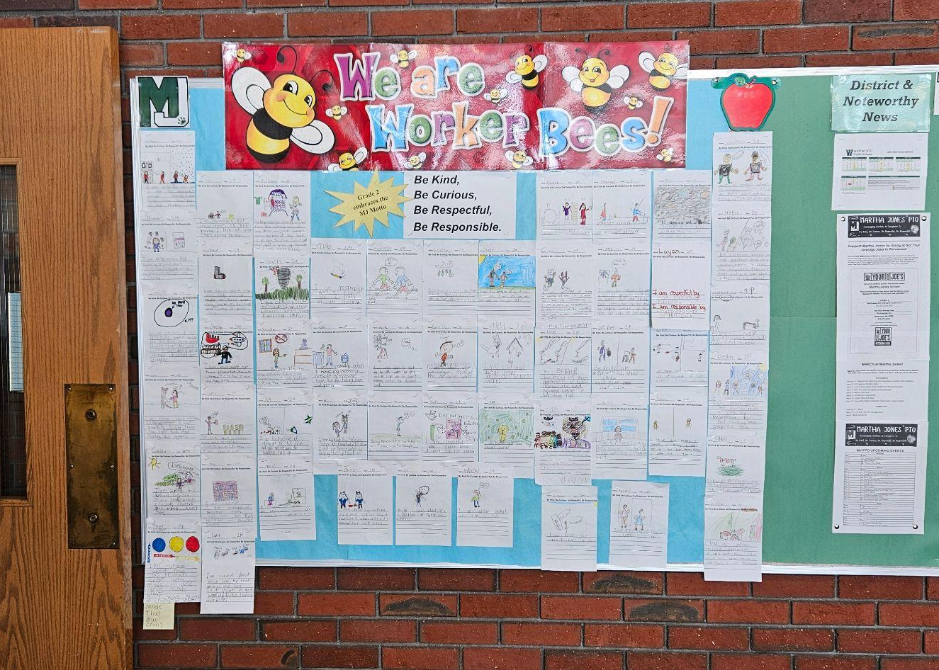
Seen Around WPS…
Notes:
Martha Jones: Second graders created art work to share with their classmates through words and pictures how they embrace one of the MJ Core Values.

Slide 6


Seen Around WPS…
Notes:
TMS: Eighth graders participated in the Book Buddies program where TMS students read to first graders across the district.

Slide 7

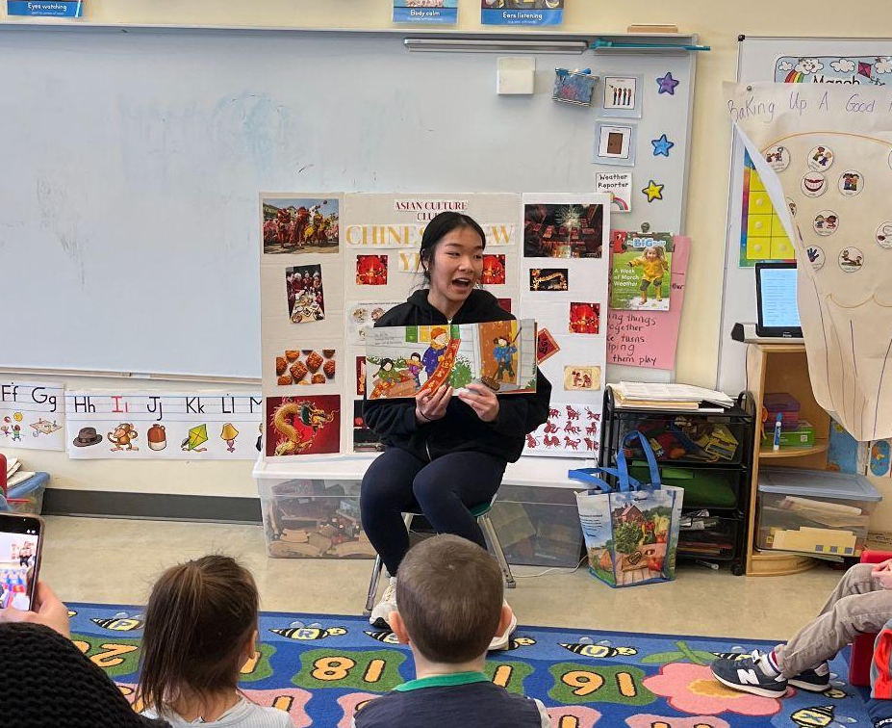

Seen Around WPS…
Notes:
WHS: The high school Asian Culture Club and Mandarin language class had their annual visit to the Integrated Preschool where they taught in the classroom, showed cultural artifacts and performed Chinese yoyo.

Slide 8

Chair’s Update

Slide 9
Fiscal Year 2026
Budget Update

Slide 10
MSBA Statement of Interest

Slide 11
Statement of Interest
The submission of a Statement of Interest (SOI) is the required first step in the process of partnering with the Massachusetts School Building Authority (MSBA) to support addressing the needs of Thurston
If accepted into the MSBA pipeline, there is the potential to access tens of millions of dollars of state funding to support an eventual Thurston project
The Statement of Interest will identify the needs of Thurston, and will include not only the needs of the facility as a building, but also how those needs impact the delivery of education in the school

Slide 12
Statement of Interest - Priorities
In submitting a Statement of Interest, the Distrct must identify which of the MSBA’s predefined priorities are applicable for the identified school
The following priorities were identified for Thurston:
Priority 2: Elimination of existing severe overcrowding
Priority 5: Replacement, renovation, or modernization of school facility systems, such as roofs, windows, boilers, heating and ventilation systems, to increase energy conservation and decrease energy related costs in a school facility
Priority 7: Replacement of or addition to obsolete buildings in order to provide for a full range of programs consistent with state and approved local requirements

Slide 13
Thurston Project Timeline
March 19, 2026: School Committee vote to authorize SOI for Thurston MS
March 23, 2026: Select Board vote to authorize SOI for Thurston MS
By April 17, 2026: Submit SOI to MSBA for Thurston MS
December 2026: Potential Invitation into MSBA Pipeline

Slide 14
Thurston Project Timeline
If accepted by MSBA in December 2026 (all dates tentative):
May 2027 Town Meeting: Secure funding for feasibility study and schematic design
Spring 2027 - Late 2028: Complete feasibility study and schematic design
Early 2029: Enter into Project Funding Agreement with MSBA
Spring 2029: Town Meeting and Town-Wide Vote for Debt Exclusion
2029-2030: Detailed Design
2030-2032: Construction
Fall 2032: Building Construction Complete and New School Opens

Slide 15
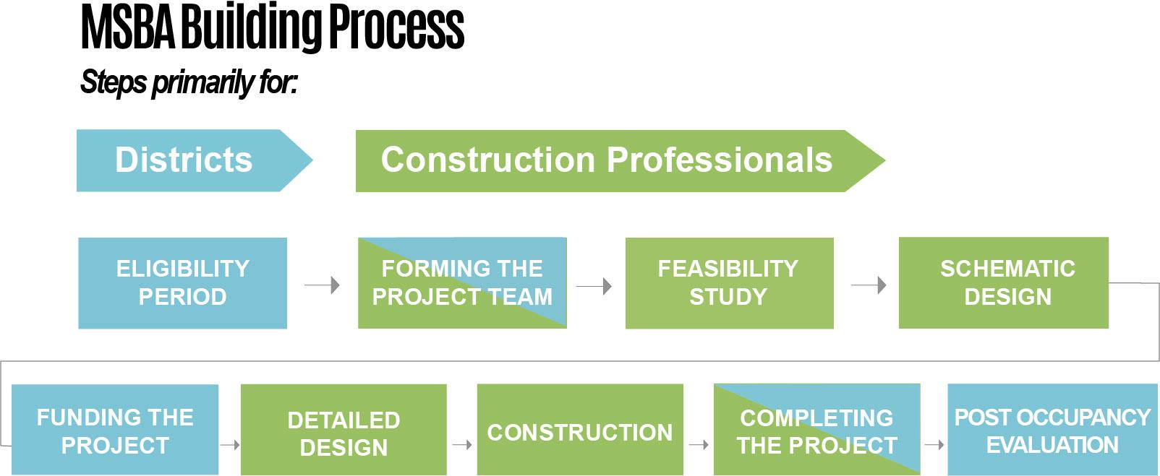
December 2026 - May 2027
Spring 2027 - Early 2029
Spring 2029
2029-2030
2030-2032
2032-2033
All dates tentative, and contingent upon acceptance into MSBA pipeline in December 2026

Slide 16
2026-2027
Early Release Dates

Slide 17
Early Release Dates
Proposed Schedule of Early Release Dates
Early release dates are scheduled approximately twice per month, with a total of 19 early release dates for professional development and contractual time.
Calendar takes into account semester timelines for report card writing and parent/teacher conference scheduling; attempts to avoid scheduling early release afternoons in weeks where school is already closed for a holiday or observance
What do teachers do during early release afternoons?
Teacher work day, by contract, is extended
Contractual time for report card writing, conferences, and team collaboration
Professional development time at the department, building, or district level

Slide 18
Second Reading:
Wellness Policy

Slide 19
Wellness Policy
Draft Wellness Policy
Proposed deletions: extraneous language
Additions:
Specific accountability around Mental Health, Digital Wellness, and Social Emotional Learning
Data-informed decision making
Proactive approach to wellness programming

